Slide 1

Group 1

Slide 2

Overview
Introduction
Visualizations
Modeling
Results
Recommendations
Next Steps

Slide 3
Business Problem
Reduce default rates by predicting a customers ability to pay back a loan
Notes:
Home credit works with clients who are unbanked or have limited access to credit. This means they might not have very much historical data when it comes to credit. This can make it difficult to predict their risk of default. The problem Home Credit wants us to solve is to help them reduce default rates by predicting a customers ability to pay back a loan.

Slide 4
Purpose
Unlock full potential of Home Credit’s data
Create a model that accurately predicts whether someone will have payment difficulties
Improve accuracy of accepting clients who are capable of repayment to broaden inclusion
Notes:
The purpose of this project is to assist Home Credit in unlocking the full potential of their data. Since the data we have access to is so large, they need assistance to figure out how to use each variable and which ones can actually help them to predict default.
Because home credits clients might not have much history with banks, it can be hard to accurately predict their ability to repay. We want to improve the accuracy of accepting clients who can repay their loans. To improve the accuracy of prediction, we must find other variables than the normal ones other banks use.

Slide 5
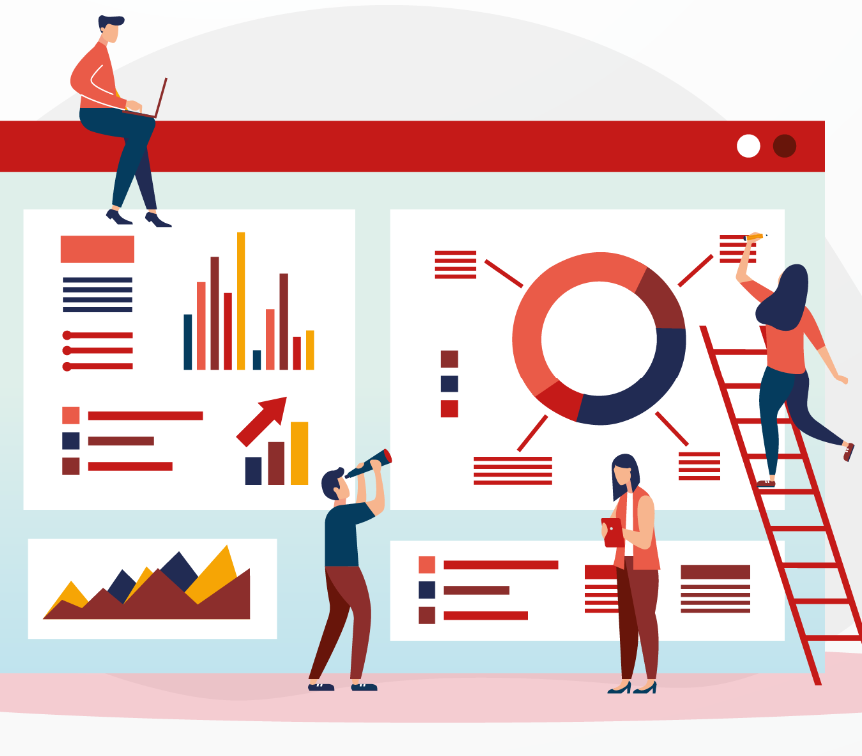
Introduction to Data
Large Amount of Data
Target Variable
Joined Data from 7 Datasets
Removed Variables
Notes:
Finlay: The data we are given to work with includes 8 different dataset that include transactional and bureau data. We also get data about the clients spending history and some personal information about them.Our target variable is binary and indicates whether a client defaults or does not default. We were able to join all the datasets together to make it easier to access all the data. We also had to decide to remove some variable because of how large the dataset was. We removed variables that had an extreme amount of missing values and once that seemed to have low significance to the target variable.

Slide 6
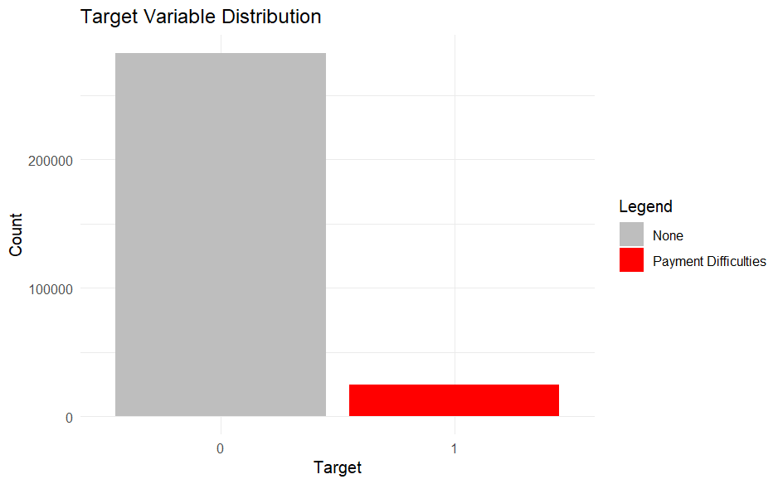
Visualizations
Notes:
When we looked into the target variable, we found that it was very unbalanced. This bar chart shows just how many more clients did not default than ones that did default. This means we had to work with a small amount of people who actually defaulted and we needed to figure out why these select did.

Slide 7
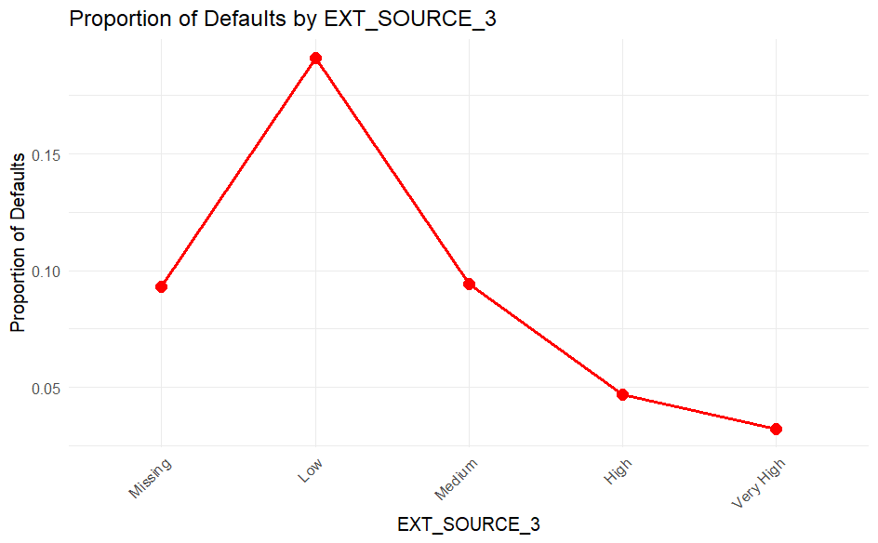
Notes:
We first wanted to observe variables that typical banks would look into to figure out whether to accept a loan application or to deny it. We had 3 external source scores variables. We do not know the exact specifics of what these scores are but we are going to think of them like credit scores. We were able to find out something that was kind of expected. Thoses who had lower credit scores had a higher proportion of defaulters and the proportions of clients with very high credit scores that defaulted is very low. This is somewhat typical to expect, we knew these could be useful in our modeling process, however, the biggest take away we learn from this visualization was the missing values. Since our clients are unbanked, we have many clients who dont have a credit score. So how are we supposed to use this to predict for them? We cannot and we realized we had to look into different predictors for these clients.

Slide 8
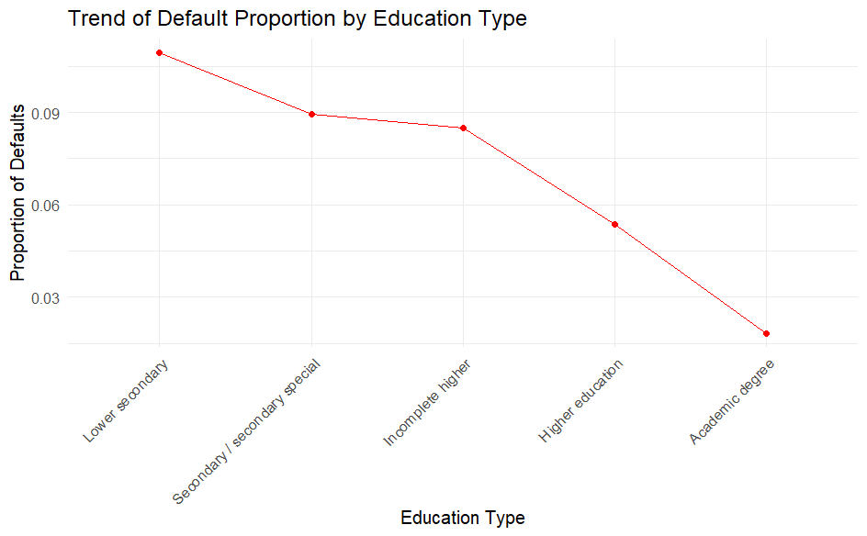
Notes:
We next looked into education type of the clients. We found a trend of thoses with higher education were less likely to default compared to those with a lower education history. After observing more information about the clients, we realized how demographics may play a role into predicting default risk.

Slide 9
Modeling
3 Unique Approaches
Naive Bayes
Random Forest
Logistic Regression
Notes:
The purpose of modeling is to create a way to predict customer defaults. We took 3 different approaches to modeling. 6 models total. Performance was measured using AUC and Kaggle score.

Slide 10
Model | AUC | Public Score | Private Score
Naive Bayes | 0.7107 | 0.52578 | 0.52564
Random Forest | 0.6959 | 0.64202 | 0.64318
Base | 0.7207 | 0.70933 | 0.70202
Model 1 | 0.7427 | 0.73214 | 0.72993
Model 2 | 0.7432 | 0.73524 | 0.72926
Model 3 | 0.7473 | 0.73880 | 0.73291
Notes:
Naive bayes: good for categorical variables which this dataset has a lot of, this model was also very quick and easy to work with compared to our other models. Since the features in this dataset are complex and naive bayes assumes independence, this model does not perform as well in the kaggle score. Naive bayes lacks that it misses these complexities.

Slide 11
Model | AUC | Public Score | Private Score
Naive Bayes | 0.7107 | 0.52578 | 0.52564
Random Forest | 0.6959 | 0.64202 | 0.64318
Base | 0.7207 | 0.70933 | 0.70202
Model 1 | 0.7427 | 0.73214 | 0.72993
Model 2 | 0.7432 | 0.73524 | 0.72926
Model 3 | 0.7473 | 0.73880 | 0.73291
Notes:
Random forest: good for complex features and non linear relationships, it better handles the imbalance of the target variable compared to naive bayes. Random forest can be hard to interpret and understanding the decision making process can be difficult since the data is so complex.

Slide 12
Model | AUC | Public Score | Private Score
Naive Bayes | 0.7107 | 0.52578 | 0.52564
Random Forest | 0.6959 | 0.64202 | 0.64318
Base | 0.7207 | 0.70933 | 0.70202
Model 1 | 0.7427 | 0.73214 | 0.72993
Model 2 | 0.7432 | 0.73524 | 0.72926
Model 3 | 0.7473 | 0.73880 | 0.73291
Notes:
Logistic regression: easy to interpret, can make direct links between the impact of a feature on default risk, easily showed which predictors are the most informative of defaulting, good base model. Base = simple log regression model to get a better idea of how it would perform.
With logistic regression, had to do lots of cleaning to handling missing values and outliers.

Slide 13
Model | AUC | Public Score | Private Score
Naive Bayes | 0.7107 | 0.52578 | 0.52564
Random Forest | 0.6959 | 0.64202 | 0.64318
Base | 0.7207 | 0.70933 | 0.70202
Model 1 | 0.7427 | 0.73214 | 0.72993
Model 2 | 0.7432 | 0.73524 | 0.72926
Model 3 | 0.7473 | 0.73880 | 0.73291
Notes:
Logistic regression with variables of high significance

Slide 14
Model | AUC | Public Score | Private Score
Naive Bayes | 0.7107 | 0.52578 | 0.52564
Random Forest | 0.6959 | 0.64202 | 0.64318
Base | 0.7207 | 0.70933 | 0.70202
Model 1 | 0.7427 | 0.73214 | 0.72993
Model 2 | 0.7432 | 0.73524 | 0.72926
Model 3 | 0.7473 | 0.73880 | 0.73291
Notes:
Logistic regression with variables that we would assume have high significance

Slide 15
Model | AUC | Public Score | Private Score
Naive Bayes | 0.7107 | 0.52578 | 0.52564
Random Forest | 0.6959 | 0.64202 | 0.64318
Base | 0.7207 | 0.70933 | 0.70202
Model 1 | 0.7427 | 0.73214 | 0.72993
Model 2 | 0.7432 | 0.73524 | 0.72926
Model 3 | 0.7473 | 0.73880 | 0.73291
Notes:
Model 3: logistic regression, used both variables that were highly significant and ones that we logically thought would be relevant to default risk.

Slide 16
Results
Model 3
Balance of highly significant and real-world relevant predictors
Demographics highly predict loan default
Notes:
AUC of about 0.75, kaggle score of about 0.74 for model 3, used p value to see how significant predictors were. Also used what we know about why people usually default on loan in the real world and it usually has to do with income and historical credit. Since we are working with clients who are unbanked or have limit expericence with credit, we used our logical of what usually impacts or correlates with ones income/credit. Demographics like education level, housing type, occupation type, family size, and others could help use predict if someone might default.

Slide 17
Recommendations
Using the model to predict a customers behavior
Key variables to look at are the external credit scores, credit amount of the loan, current credit bureau debt, and days employed
Customer Segmentation
Notes:
Finlay: Our analysis found that certain demographic variables provide strong signals of default risk. We recommend leveraging these features in the model, while taking care to follow fair lending practices and assess for bias. In addition, we suggest using demographic insights to support customer segmentation, targeted interventions, and ongoing model monitoring. Since we found that demographics can help us predict loan default, we have to be aware of not using this information to become bias or discriminate against certain groups of people.

Slide 18
Next Steps
Communicate with stakeholders
Test additional models
Feature engineering
Apply customer(risk) segmentation
Notes:
Finlay:

Slide 19
Questions?

